Slide 1
Notes:
Nature Space is a website for groups, individuals and landowners undertaking ecological restoration in New Zealand. Its purpose is to create a national picture of community conservation efforts. Nature Space is free to anyone who wants to promote their conservation group and have a digital presence with other community groups doing conservation work throughout New Zealand. The link to Nature Space is http://www.naturespace.org.nz/ and to sign up as a group is http://www.naturespace.org.nz/group-sign-up

Slide 2
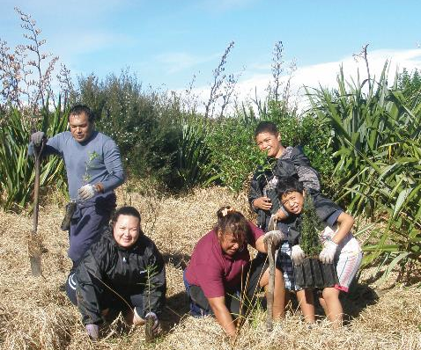
A website to link conservation groups, volunteers, families, schools
Notes:
The Nature Space website aims to link conservation groups, volunteers, whanau/families, schools and other groups actively involved in conservation. Nature Space is supported by DOC, New Zealand regional councils, WWF and QEII National Trusts. A Nature Space team from the Department of Conservation produces a monthly e-newsletter to help groups promote their events, provide information, and get in touch with one another.

Slide 3
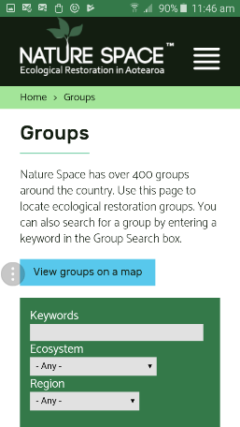
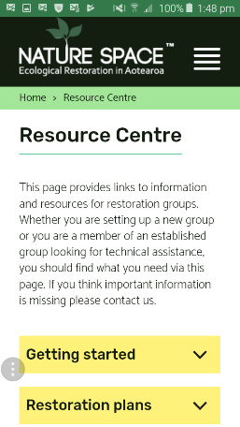
Mobile-friendly
Notes:
The website operates in a New Zealand-wide digital space which is mobile friendly.

Slide 4
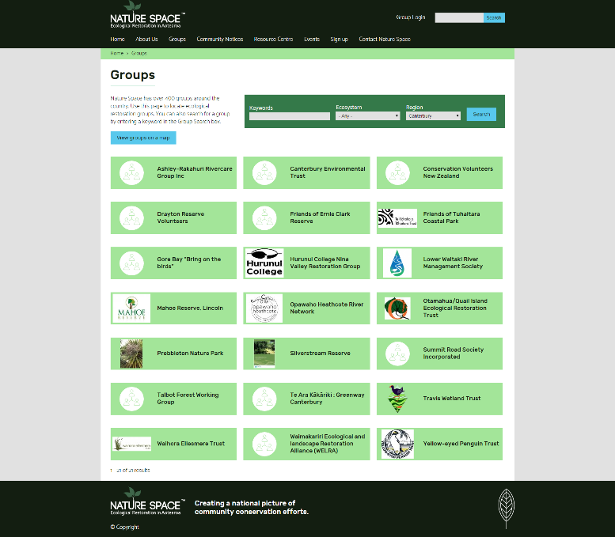
Notes:
Communities doing conservation activities can join up on the Groups page. This example shows the Canterbury groups currently present on Nature Space.

Slide 5
A few Christchurch and Canterbury pages
Notes:
Groups sign up for free to have their own group pages. The Nature Space team makes it easy for groups to do their own updating and maintenance of pages. Digital traffic is directed to their own website from users looking at the Nature Space website.

Slide 6
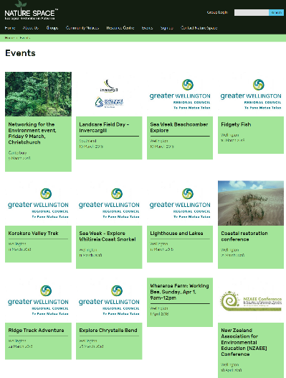
Promote your events and post notices to
reach a much wider audience
Notes:
The website helps promote community group events, post community notices, and send out information via the monthly Nature Space newsletter. Community notices are posted by the Nature Space team to advertise conservation news and events. Community notices includes updates on funding rounds, stories, conferences, and new information resources.

Slide 7
Find resources
Notes:
The resource centre is a valuable source of information. It lists funding sources, training opportunities, monitoring, and a range of other technical assistance.

Slide 8
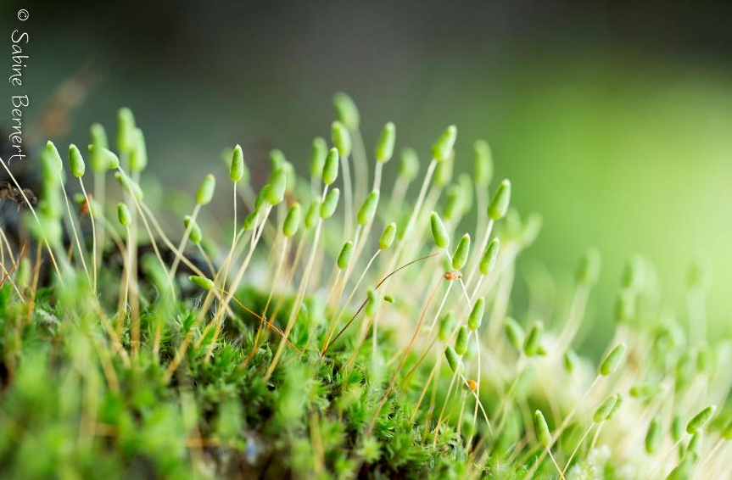
Help Nature Space evolve… give us feedback

Slide 9
Come visit us at the EXPO today
Notes:
Come and talk to us at today’s Expo. Explore the website, join our e-newsletter list and learn how to sign up your group.

